Slide 1

CSE424 (PATTERN RECOGNITION)
RESEARCH PAPER PRESENTATION - 2
PRESENTED BY: FAIYAZ BIN YOUSUF
ID: 22101845

Slide 2




TABLE OF CONTENTS
Summary
1.1 Motivation
1.2 Contribution
1.3 Methodology
1.4 Conclusion
Limitations
Synthesis

Slide 3


A BRIEF SUMMARY OF THE PAPER
Paper Information
TITLE:
Hybrid CNN-SVM classifier for efficient depression detection system
AUTHORS:
Afef Saidi, Slim Ben Othman, Slim Ben Saoud
Summary
The paper introduces a hybrid CNN-SVM model for automated depression detection using audio with accuracy (68%).
Spectrograms, derived through the Short-Time Fourier Transform, serve as input, allowing CNN to extract acoustic features automatically.
Support Vector Machines (SVM) then classify the features, creating a system for distinguishing between depressed and non-depressed speech.
The proposed model holds promise for practical applications in mental health, offering an efficient and accurate tool for early depression detection.

Slide 4

1.1 Motivation
Rising global depression rates
Costly, Complex and Underutilised Traditional Diagnostic Methods
Lack of Automated Systems
Globally, approximately 300 million people suffer from depression, as reported by the World Health Organization (WHO)
Traditional depression diagnostic methods, relying on clinical interviews, face significant challenges, contributing to an estimated 4.4% of the world's population being affected by depression.
The prevalence of depression continues to rise annually, emphasizing the critical need for automated and accessible detection systems.

Slide 5


1.2 Contributions
Introduces a hybrid CNN-SVM model for automated depression detection.
CNN extracts vital features from speech spectrograms automatically.
SVM improves classification, achieving 68% accuracy.
Outperforms previous audio-based approaches.

Slide 6
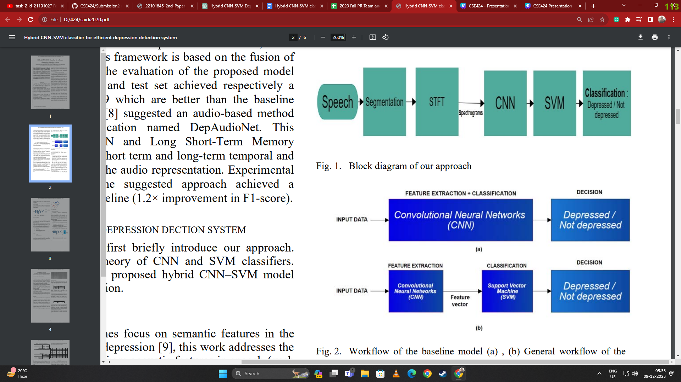

1.3 Methodology
Data Collection
Preprocessing
Feature Extraction and Classification

Slide 7
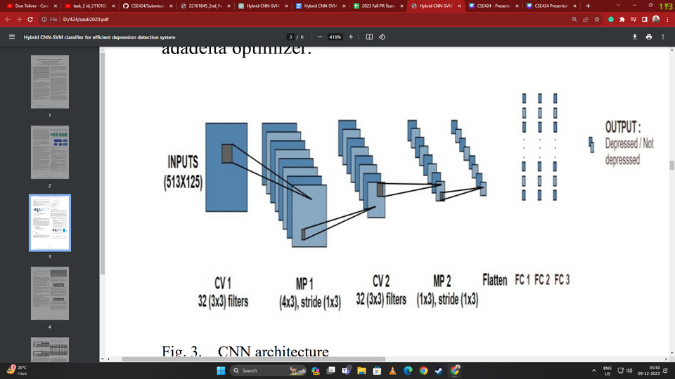
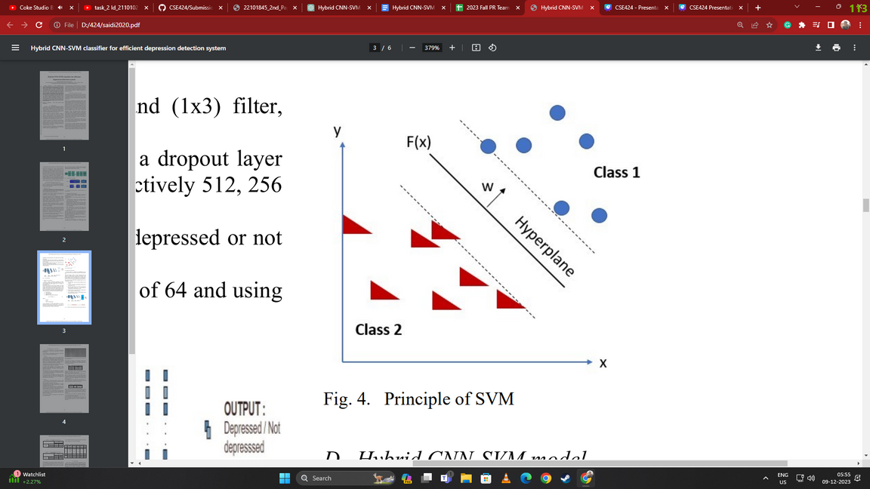
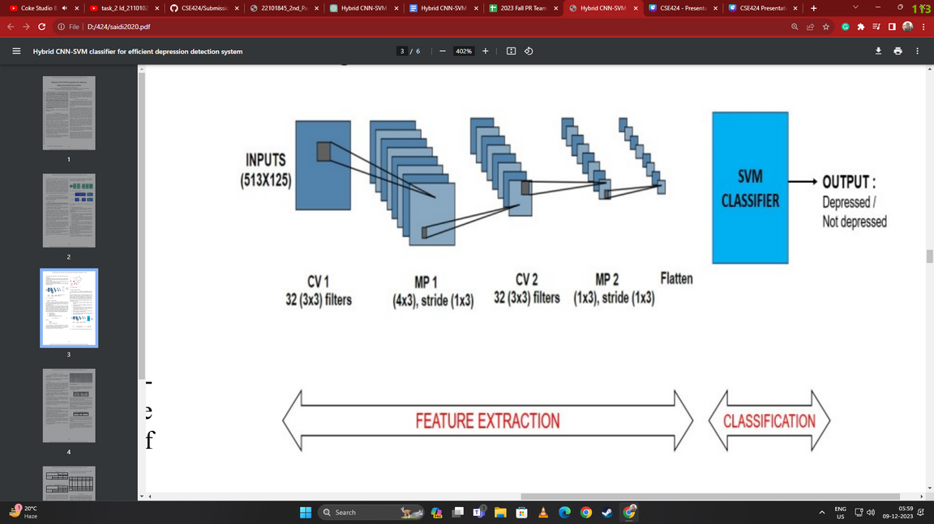
Principle of SVM
1.3 Methodology (Continued)
CNN Architecture
CNN
SVM Classification
Hybrid CNN-SVM Model
Hybrid CNN-SVM Model

Slide 8
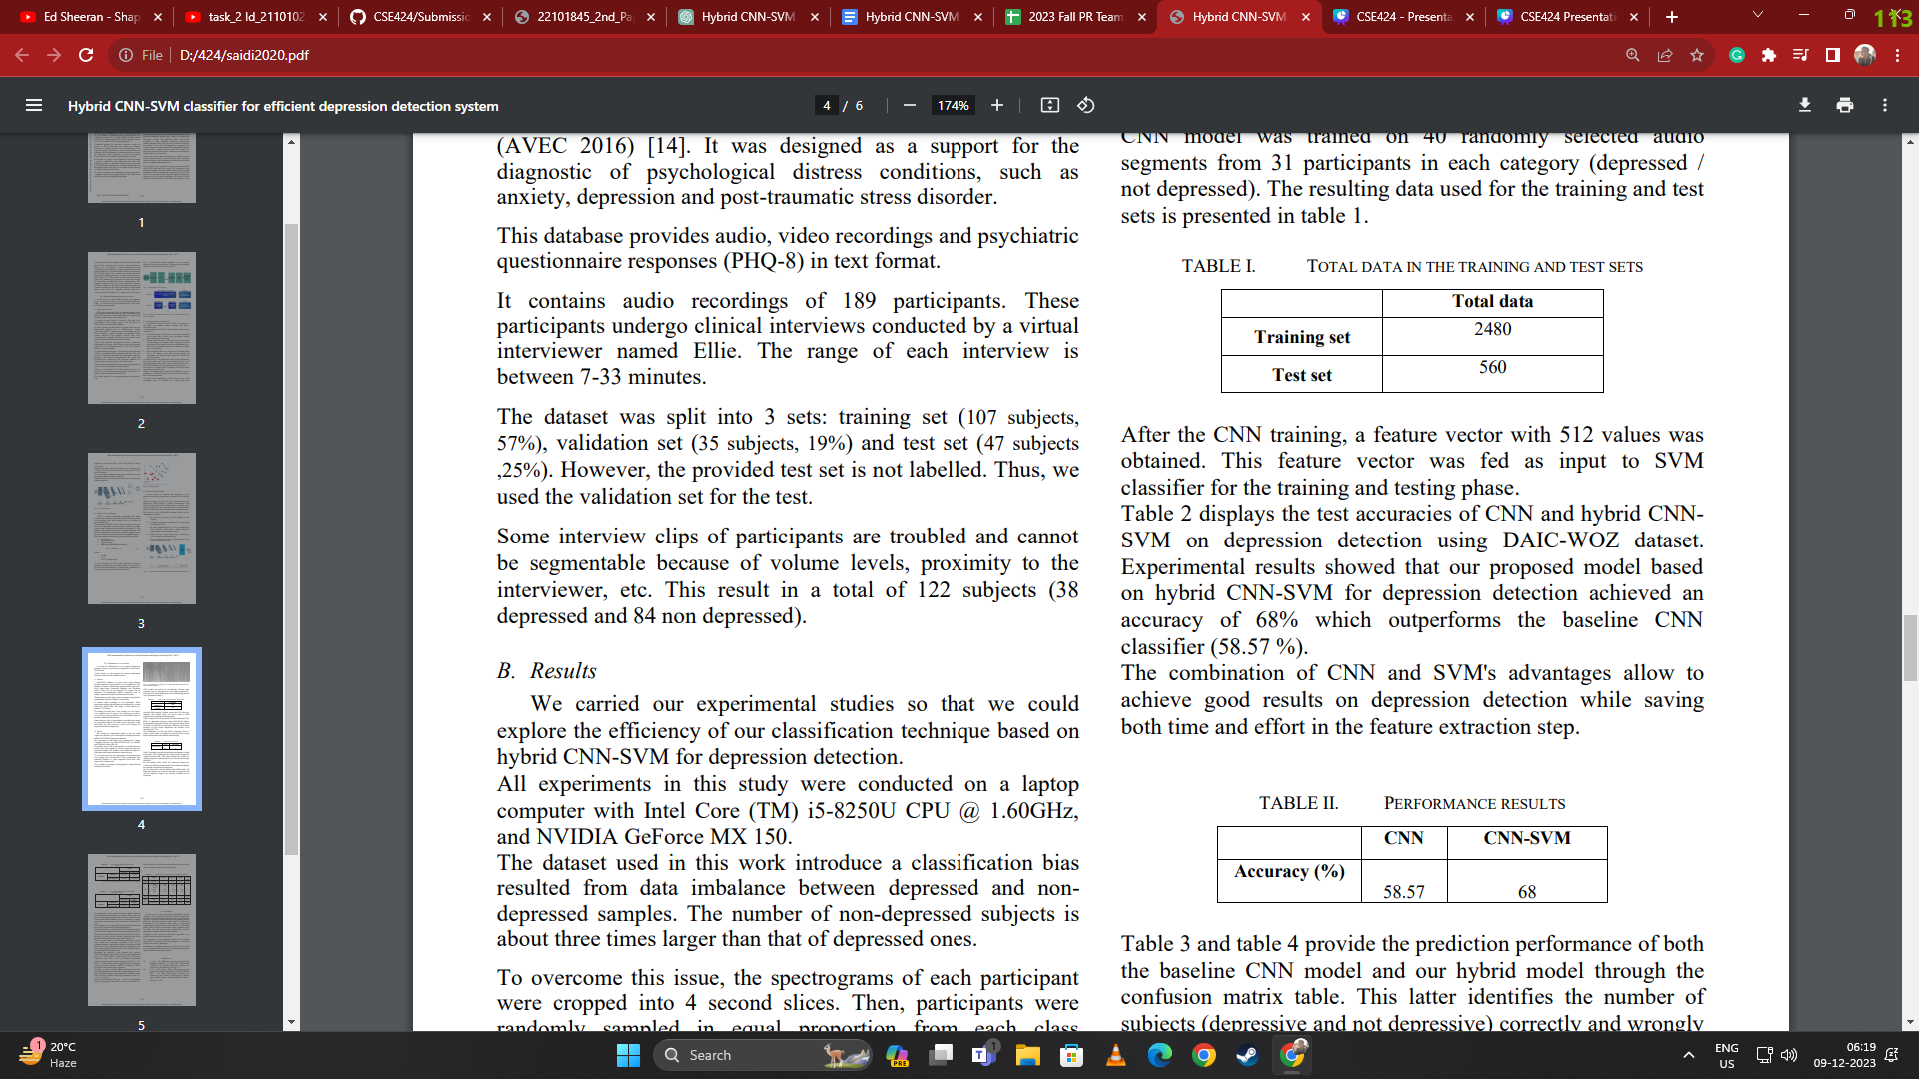


Experimental Results
Training and Evaluation:
The model was trained on a portion of the dataset and evaluated using the remaining samples.
Performance was assessed using metrics such as accuracy, precision, recall, and compared with baseline CNN models
Results Analysis:
Hybrid CNN-SVM Model Accuracy
The hybrid CNN-SVM model achieved a 68% accuracy in depression detection, outperforming the baseline CNN model (58.57%) and demonstrating improvements in precision and recall.
Normal CNN Model Accuracy

Slide 9
1.4 Conclusion
Hybrid CNN-SVM achieves 68% accuracy, outperforming standard CNN methods.
Integration of CNN and SVM enhances the precision of finding depression, more accurately.
Validation of the DAIC-WOZ dataset confirms practical effectiveness in real-world scenarios.
Promising potential for accessible tools in early depression detection.
Success with the hybrid model is a big step for finding depression automatically.

Slide 10


2. Limitations
01.
Dataset Limitation
The study acknowledges the data imbalance in the DAIC-WOZ dataset, addressed through random sampling and segmentation which could impact the model's generalization
02.
Feature Extraction Challenges
The study also recognizes limitations in capturing all nuances of depression through audio data, suggesting improvements in data collection.

Slide 11

3. Synthesis
Real-World Application
Future Research Avenues
Clinical Implementation
Global Mental Health Impact
Technological Advancements

Slide 12

THANK YOU!

